Slide 1
Triglyceride Synthesis

Slide 2
Quiz Question #1
What dietary factor is most associated with increased LDL cholesterol?
Saturated fatty acids
Monunsaturated fatty acids
Polyunsaturated fatty acids
Fiber

Slide 3
Quiz Question #2
What does reverse cholesterol transport refer to?
Transport of cholesterol from the gut lumen to the liver
Transport of cholesterol from the liver to the periphery
Transport of cholesterol from the periphery to the liver
Transport of cholesterol within cells to nascent VLDL particles

Slide 4
Learning Objectives
Identify the functions of cholesterol within our body
Understand that cholesterol homeostasis is highly regulated in the body
Describe the main carriers of cholesterol throughout the body
Understand the etiology of “high” cholesterol and its potential role in atherosclerosis
Describe how triglyceride synthesis is regulated in the liver, and how liver triglycerides are transported to other tissues

Slide 5
Overview of Lipid Metabolism
Fatty Acid Metabolism
Obtaining Fatty Acids from Diet
Making Fatty Acids de novo
Oxidizing Fatty Acids
Triglyceride Metabolism
Synthesizing new triglycerides
Transport of Triglycerides from Liver to other Tissues
Mobilizing Fatty Acids from Triglycerides
Cholesterol Metabolism
Cholesterol Synthesis
Cholesterol Excretion (Bile Salts)

Slide 6
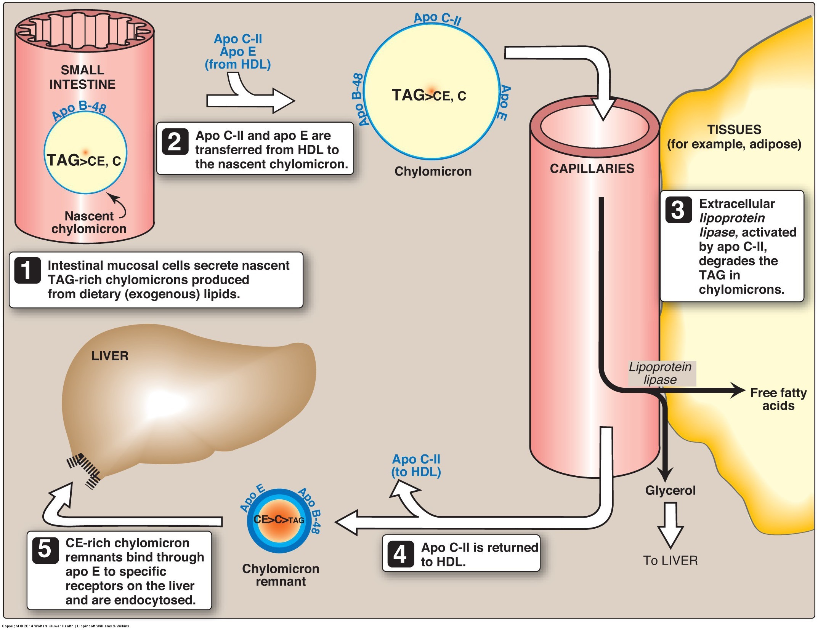
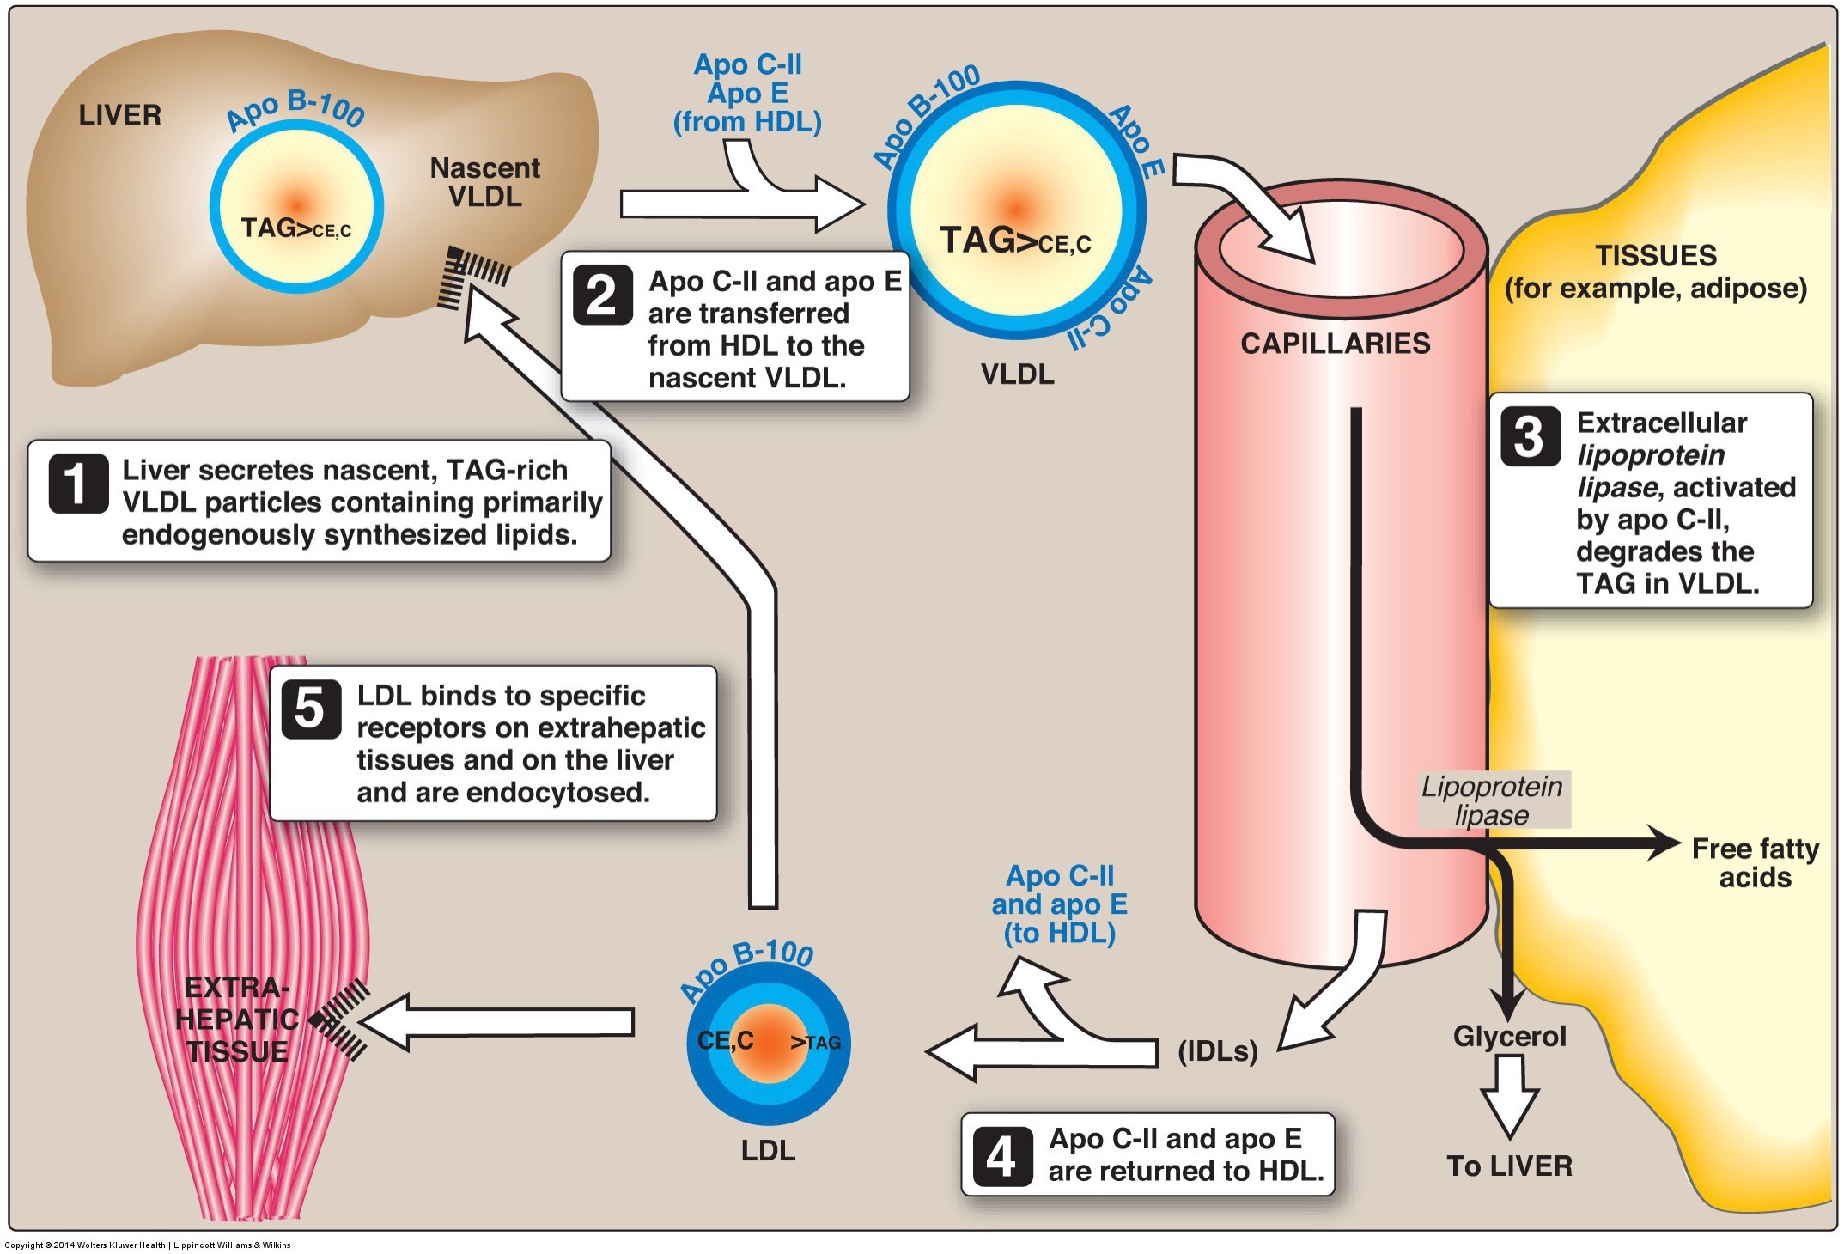
Triacylglycerol Synthesis
Mainly synthesized in liver and adipose tissue
Small amount from de novo lipogenesis
Primarily fatty acids from dietary fat
In the liver triglycerides are synthesized, then packaged for transport to adipose tissue via VLDL

Slide 7
Requirement for Glycerol-3-Phosphate
Adipose tissue needs to make Glycerol-3-Phosphate from Glycolysis -> needs glucose!
Liver has Glycerol Kinase, so can make from glycerol released from lipolysis

Slide 8
Sequential addition of Fatty Acids
Sequential addition to sn1, sn2 then dephosphorylation then sn3 position.
DGAT, GPAT and Lipin/PPH-1 all regulated by SREBP and ChREBP
Also known
as Lipin

Slide 9
How to get fatty acids from adipocytes to other tissues
Does not have machinery to make VLDL like the liver does
Dependent on lipolysis, which is inhibited by…
Adrenaline
Glucagon
Insulin
Cortisol

Slide 10
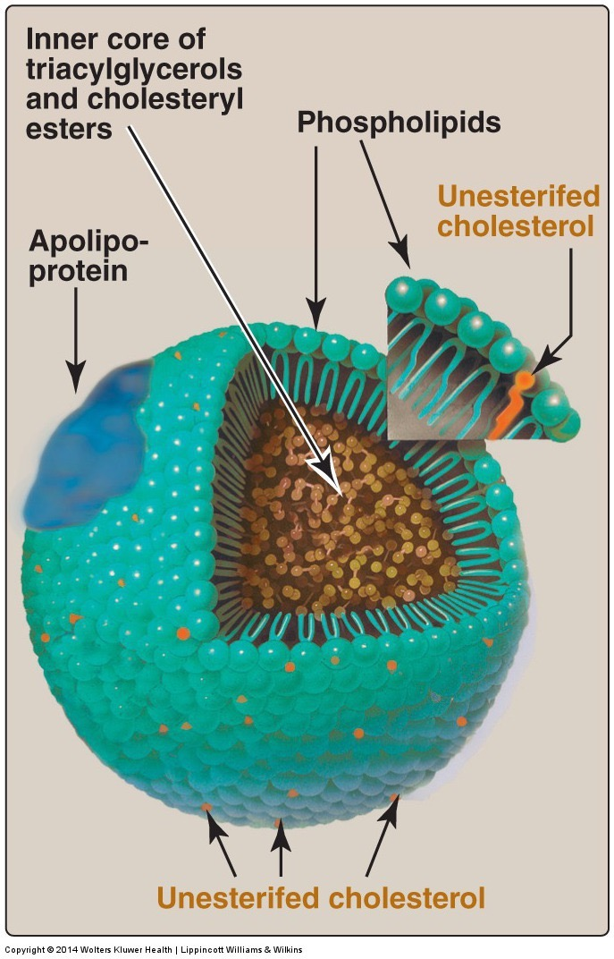
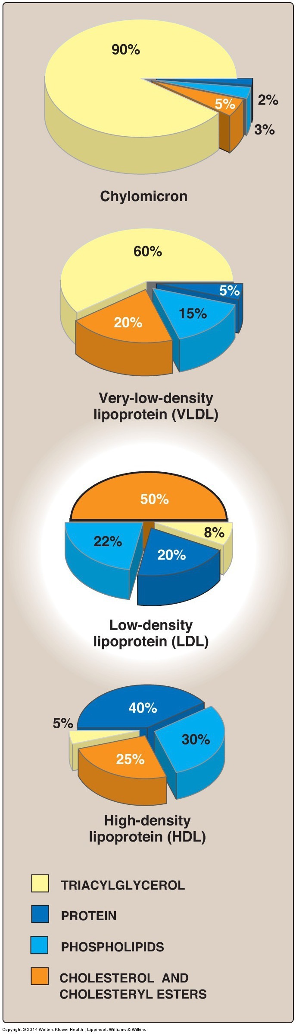
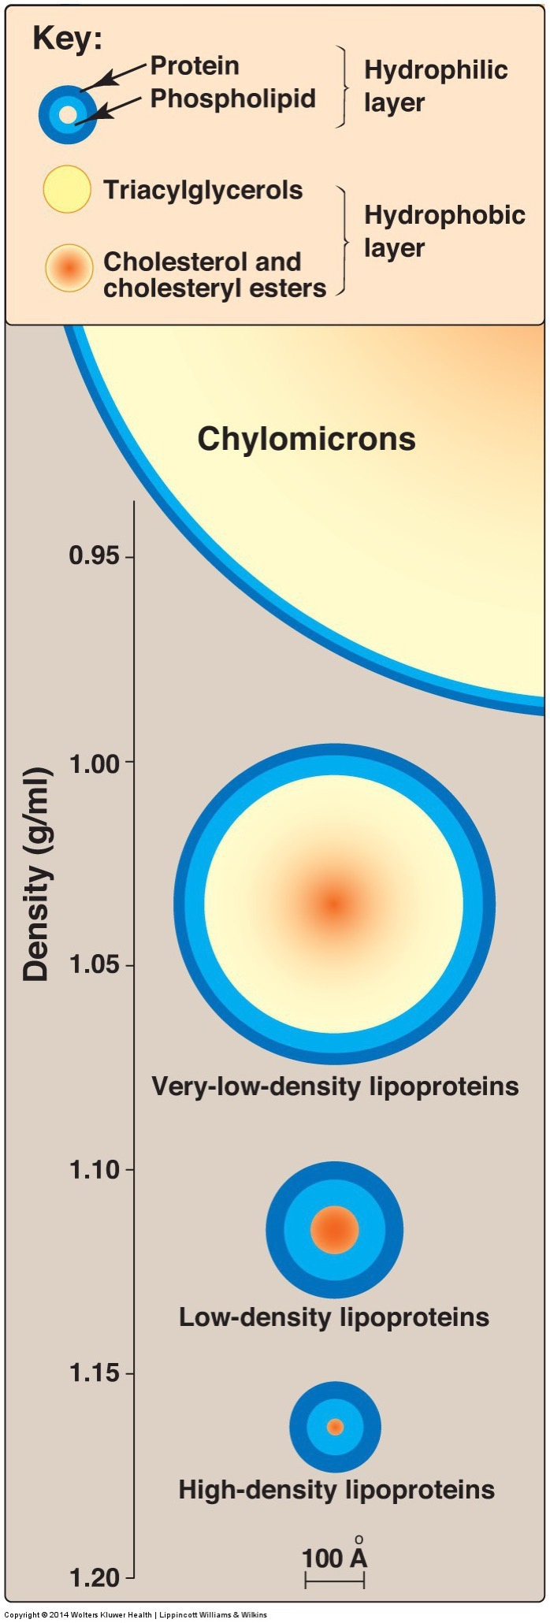
Lipoprotein Particles and Composition

Slide 11
Triglycerides from Chylomycrons and VLDL

Slide 12
Production of VLDL by the Liver

Slide 13
Lipoprotein Particle Composition
Class | Composition | Apolipoproteins
Chylomicron | Mainly TG | A-V, B-48, C-II, C-III, E
Chylomicron Remnant (CR) | Mainly Cholesterol | B-48, E
VLDL | Mainly TG | A-V, B-100, C-II, C-III, E
IDL | TG/Cholesterol | B-100, E
LDL | Cholesterol | B-100
HDL | Empty | A-I, A-II, C-II, E
Receptor | Particle | Ligand | Tissues
LDLR | LDL, CR | B-100, E | Liver
SR-BI | HDL |  | Liver
LPL | Chylomicron/VLDL | CII | Peripheral
CII activates Lipoprotein Lipase
CIII inhibits Lipoprotein Lipase
Notes:
CII lost as triglycerides are depleted

Slide 14
Fatty Acids are Liberated from TG by Lipoprotein Lipase in Most Tissues
LPL highly expressed in heart, muscle, fat
Secreted by cells to ECM
Activated by Apolipoprotein on Chylomicron/VLDL (ApoCII)

Slide 15
Nutritional Control of LPL Activity -The Role of ANGPTL4

Slide 16
Mutations in VLDL/LPL System
https://twitter.com/skathire/status/839151207436419072

Slide 17
Cholesterol Synthesis and Transport

Slide 18
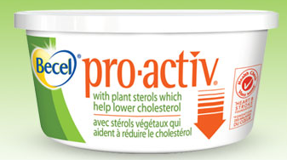
Cholesterol
Sterol family
Plant sterols
Cholesterol – animal products
Plant sterols interfere with cholesterol absorption

Slide 19
Cholesterol
Dietary intake plus biosynthesis of cholesterol is about 1 g/day
US intake estimated around 300-600 mg/day (0.3g/day)
Biosynthesis accounts for up to 60-70% of total daily cholesterol
Highly regulated
Mainly in liver, but can occur in all nucleated cells

Slide 20
HMG-CoA Reductase is the Rate Limiting Enzyme for Cholesterol

Slide 21
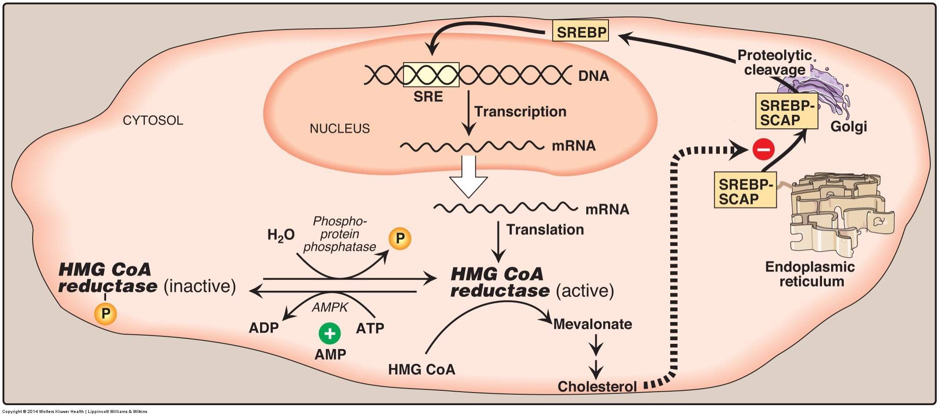
Cholesterol Biosynthesis Regulation
Negative feedback system of mevalonic acid and endogenous cholesterol on HMG CoA reductase
Regulated by SREBP2 and AMPK
Dietary intake of cholesterol suppresses production only in liver

Slide 22
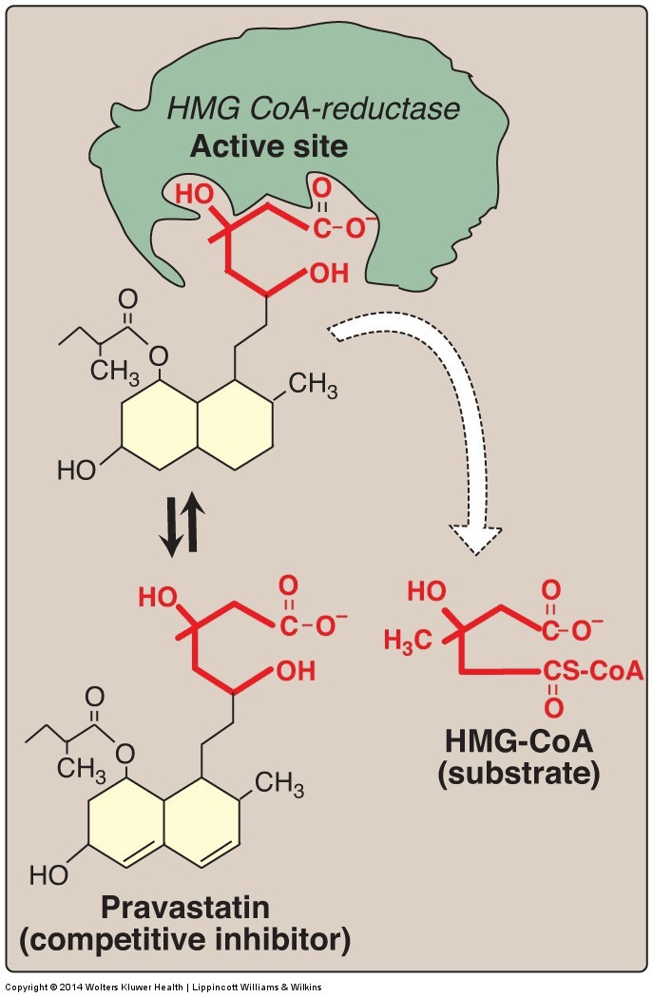
Statins inhibit HMGCR
Widely prescribed cholesterol lowering drugs
Active site inhibitors of HMG-CoA reductase

Slide 23
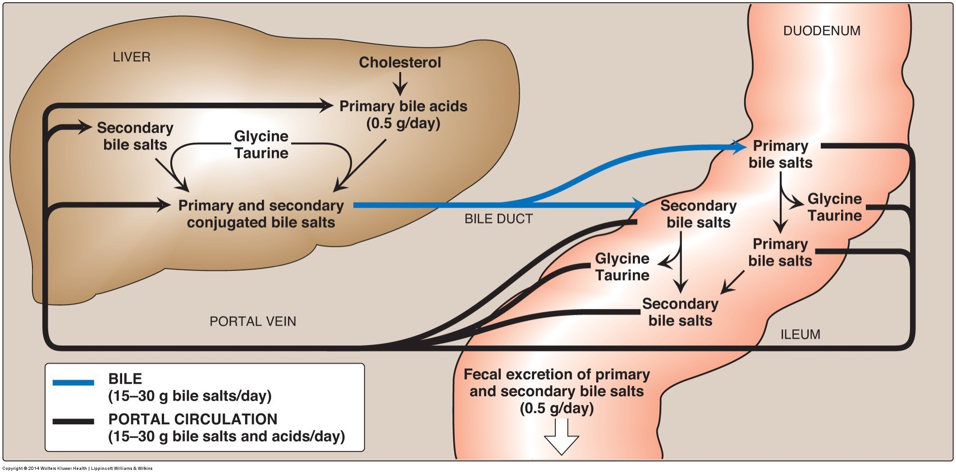
What is the main route of cholestrol disposal?
Oxidized in muscle tissue
Secreted as bile
Converted to hormones

Slide 24
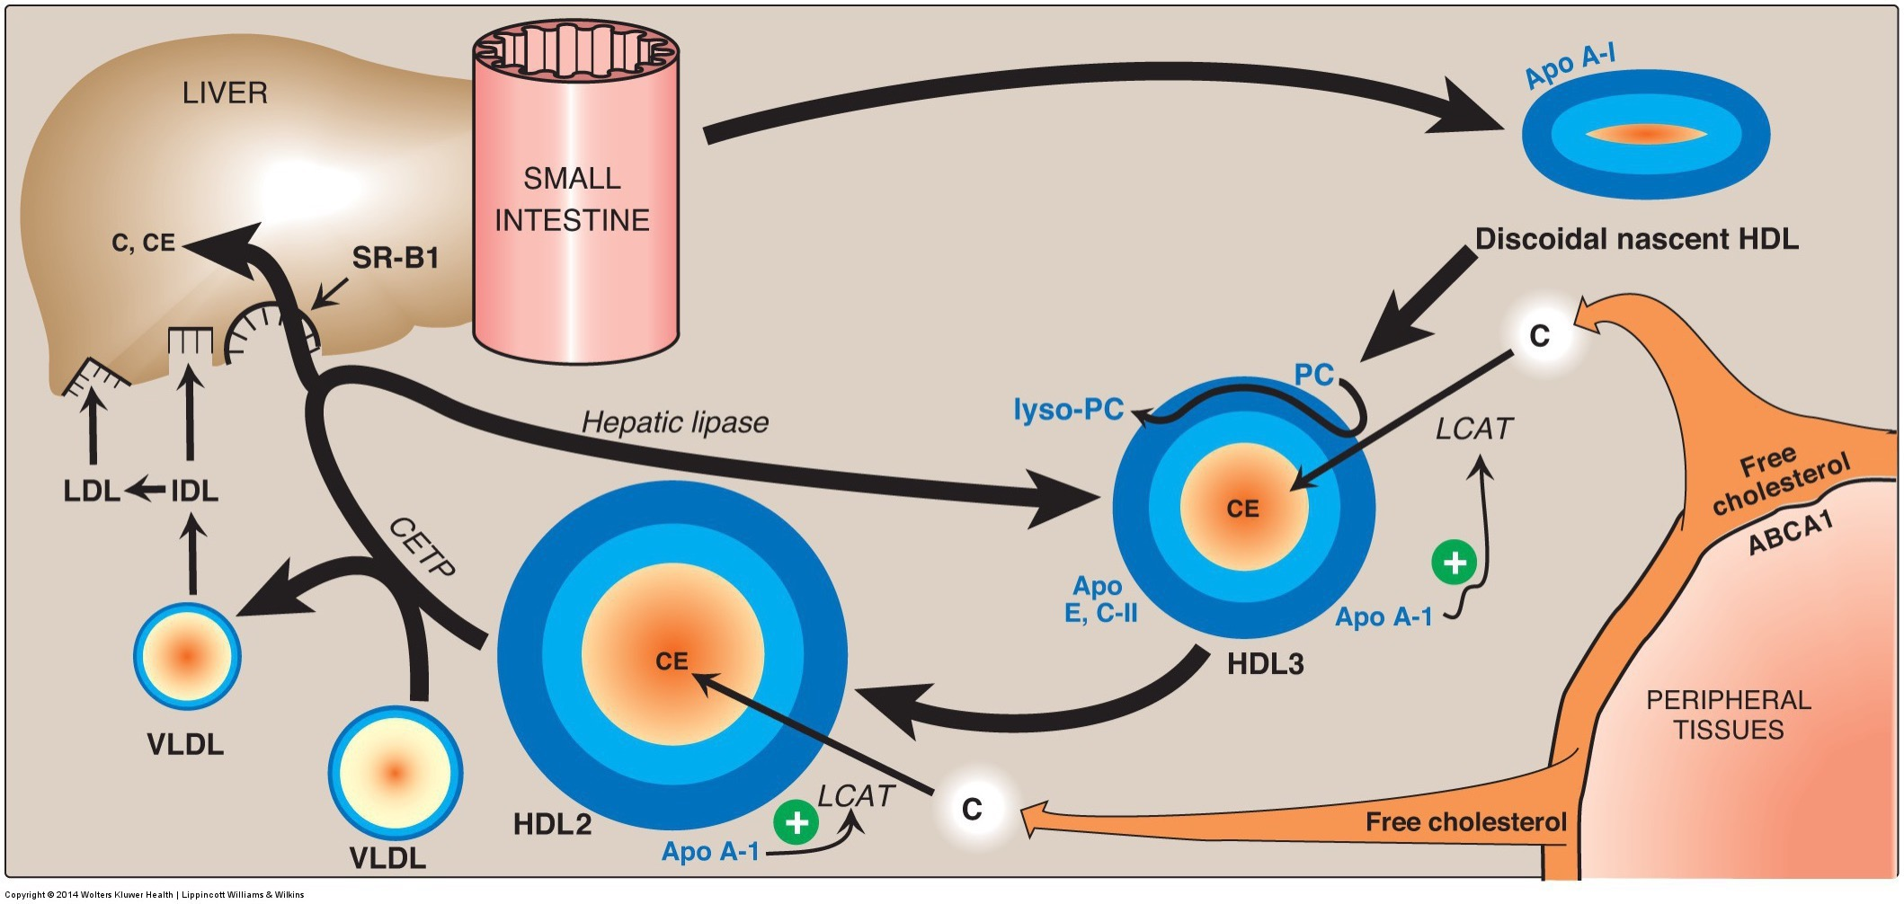
Retrieval of Cholesterol from Tissues
Soaks up cholesterol from other tissues
Taken up by liver via LDLR or SR-B1

Slide 25
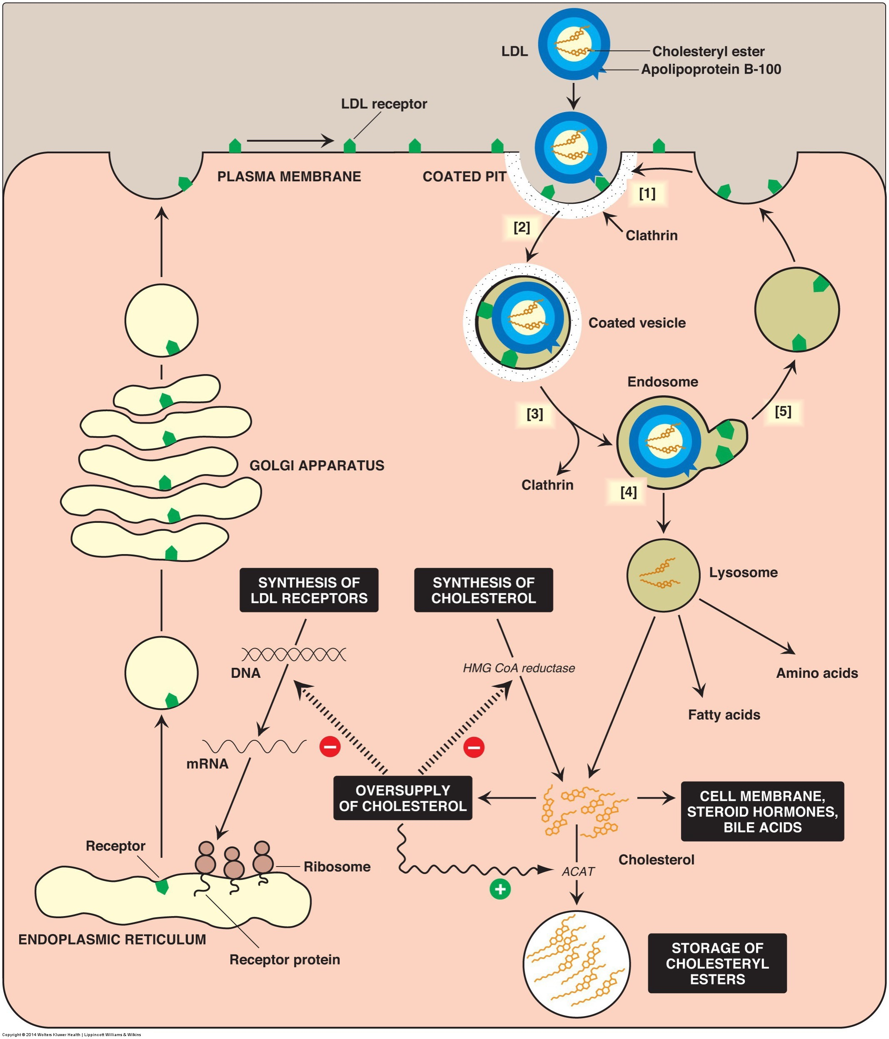
Regulation of LDL Uptake in the Liver
LDL from
Depleted VLDL
Cholesterol rich HDL
High cholesterol
Inactivation of SREBP2
Less LDL Receptors
Less HMGCR

Slide 26
LDLR Mutations
Cells unable to bind LDL via LDLRs (mutant cells)
Mutant cells – defect of chromosome 19
110 mutations effecting differing domains of LDLR
Broad term called Familial Hypercholesterolemia
1 in 500 carry at least one mutation
Emily C. O’Brien, PhD, et al. Rationale and design of the familial hypercholesterolemia foundation CAscade SCreening for Awareness and DEtection of Familial Hypercholesterolemia registry. American Heart Journal. 167:3. March 2014

Slide 27
LDLR Mutations
Physiological outcomes:
Altered synthesis of LDLRs results in abnormal levels and functioning of receptors at cell membrane
Accelerated biosynthesis of cholesterol – HMG CoA reductase remains activated
Results in high LDL levels in blood
Diet can be contributing factor to high serum LDL
Controlled by drugs, dietary restrictions, exercise
Statins - class of drugs inhibiting HMG CoA reductase

Slide 28
Cholesterol and Cardiovascular Risk
Seven Nations Study – Ancel Keys
Cholesterol rises in proportion to saturated fat
Coronary events rose in proportion to serum cholesterol
13 fold higher in Finnish Forresters (270 mg/dL) than Japanese Fisherman (165 mg/dL)
Further studies linked cardiac risk to high LDL and low HDL

Slide 29
Lipid and CVD Risk – Atherosclerosis
Macrophages contain scavenger receptors
Receptors can bind oxidized LDL and LDL
Macrophage internalizes LDL
Platelets, cellular debris, calcium too
Build-up of LDL inside of macrophage results in foam cell
Foam cell accumulate in blood vessel (plaque buildup)
Thickening of vessel wall
Results in occlusion of blood vessels

Slide 30
New Dietary Guidance Regarding Cholesterol
Previously, the HHS/USDA Dietary Guidelines for Americans suggested limiting cholesterol to < 300 mg/day
As of 2015 this was removed:
“…available evidence shows no appreciable relationship between consumption of dietary cholesterol and serum (blood) cholesterol”

Slide 31
Learning Objectives
Identify the functions of cholesterol within our body
Understand that cholesterol homeostasis is highly regulated in the body
Describe the 3 main steps of cholesterol synthesis
Describe the main carriers of cholesterol throughout the body
Understand the etiology of “high” cholesterol and its potential role in atherosclerosis
Understand why some unsaturated fatty acids are essential
Describe the different functions of omega-3 and -6 derivatives
Identify the sources of omega-3 and -6 and their derivatives

Slide 32
Mid-Term Student Feedback
Dr. Tazin Daniels
Center for Research on Learning and Teaching

